Slide 1
Kanban

Slide 2

Other Modules In This Series:
5S
Standard Work
Total Productive Maintenance (TPM)
Administrative Lean
Cell Design/ Production Preparation Process (3P)
Kaizen
Kanban
Problem Solving
Poka Yoke Quality Systems
Transaction Process Improvement (TPI)
Cause & Effect Diagram with the Additions of Cards (CEDAC)
Single Minute Exchange of Dies (SMED)
Value Stream Mapping (VSMi®)
Visual Management
Managing Daily Process Excellence
For More Information Please Contact:
Mark DeLuzio, President and CEO
+1.860.234.0915
mark.deluzio@leanhorizons.com
Strategically Creating Value Through the Elimination of Waste

Slide 3
This document contains confidential
and proprietary information owned
by Lean Horizons Consulting, LLC.
Any disclosure, use, copying or
distribution of this information without the express written consent of Lean Horizons Consulting is strictly prohibited.

Slide 4
Ground Rules for Event
Safety first (use personal protective equipment)
Active participation by all
Start and end on time
All electronic gadgets (phones, pagers, etc) turned to “off” or “silent”
Computers to be used only when instructed
Keep an open mind to change
Don’t let “perfect” get in the way of “better”
Notes:
DO: Perform Group Introductions. Pick an ice-breaker or exercise to warm the team up to the event. (Icebreaker Example: Everyone uses their name tent and writes a “Personal License Plate” in which they have 2 minutes to creatively use a total of 7 letters or numbers to tell us something about themselves. Examples “LV2SAIL” OR “DADOV5”
DO: Review Event Ground Rules.
ASK: “Does anyone have any rules they would like to see added?”
ASK: “Does everyone agree to these?”

Slide 5
Goal of Kanban Module
To understand how a Kanban system may be applied to your business, process and role.
Push vs. Pull
Types of Kanban and How Kanban Works
Kanban Calculations
Implementing Kanban
Notes:
DO: Introduce the notion of Kanban and the goal of this event.
SAY: “Specifically we want you to be able to:
Understand what is Kanban
Learn how Kanban works and why it is successful
Identify the difference between pull and push systems
Identify two different types of Kanban
Review the mechanics and calculations behind Kanban
Learn how to implement Kanban
Experience a “pilot” Kanban process
DO: Explain how you will achieve the purpose/objectives, e.g. the class is structured around a combination of lecture, discussion, examples and hand-on experience.

Slide 6
Kanban Training Overview
After completing the module, you will be able to:
Understand how a Kanban system may be applied to your business, process, and role
Apply your Kanban knowledge, experience and tools to begin building the foundation for a Kanban environment
Gain experiential knowledge and lessons learned from experts and other participants
Notes:
DO: Explain the benefits of participating in the Kanban course.
Relate how other participants in previous sessions have used the Kanban information.
ASK: “Are there other objectives they would like to achieve by attending this course?”
NOTE: You may want to circle back to this page at the end of the course to “check off” each objective, indicating that they’ve all been met.

Slide 7
Introduction to Kanban
1
2
3
Defined
When to Use
A Healthy Thought
Kanban is a pull system
Japanese word; loosely translated means card, billboard or signboard
Used to control over-production, for visual control, and as a way to link processes together
When processes cannot be linked together in a cell
When process lead time is greater than the frozen master schedule horizon
With low $ items on which the business doesn’t want to spend resources managing
“Kanban is an admission of failure to do one-piece flow.”
--Chihiro Nakao, President, Shingijutsu Co., Ltd.
Ultimately the best kanban is no kanban at all…
Notes:
DO: Explain that you will soon identify the difference between a pull system and a push system.
DO: Ask the class if they have any experience with Kanban.
SAY: Kanban itself only means “signal” in Japanese. Many people have misinterpreted kanban to mean ‘card’ or ‘container’. Kanban means signal .. The signal mechanism will be developed appropriate to the situation
SAY: “Kanban is appropriate for certain processes but not all.”
DO: Provide an example when Kanban would and would not be appropriate.
ASK: “When you have 1 piece flow, there is no need for kanban. Therefore when you have kanban, it must mean that you were unable to achieve one piece flow. What are some examples of this? (sample answers: Monuments, Poor quality, Long set up, Centralized equipment, ‘non cross functional operators, Extended Supply Chain, Inconsistent deliveries, Poor information flow, Equipment up time)
DO: Ask the participants if they can identify a process in their own shops that would be appropriate for a Kanban implementation.
Ask the class to explain what the quote means and then provide your interpretation. Finally, define the last statement.
NOTE: The Best kanban system is to have ‘no kanban system’.

Slide 8

Introduction to Kanban
It is rumored that Toyota got the idea of Kanban when visiting an American supermarket and looked at the produce.
The produce is fresh and plentiful but not so much that it will spoil on the shelf but is replenished in a timely basis.
Notes:
SAY: Few times we are able to reach a process of true pull especially when we first start. We may be able to pull in some steps in our processes and still have some push elements remaining in the same process.
Often times we may have shared resources in our process, be it machines or other processes that cannot be dedicated to a particular part.
In the case of shared equipment we would want to set in place Kanban supermarkets that we can draw from if a demand for a particular part immerges while the shared resource is producing a different part.
A pure pull system is always the goal in our pursuit of perfection however the Kanban system enables us to bridge the gap in the meantime.

Slide 9
Introduction to Kanban
A successful Kanban implementation comes later in your lean journey.
Reliable processes and equipment must come first
Understand demand and capacity
Viable and repeatable 5S and visual control
Discipline at all levels
Notes:
SAY: A successful kanban implementation comes later in your lean journey. You must have a reliable process (TQC) and reliable equipment (TPM). You must also be able to understand your demand and capacity; be able to find shared resources and understand the total demand on them; have a viable and repeatable 5S and visual control process; and finally, must have discipline at all levels of the process.
Prior to starting a Kanban, you must:
Have a robust and reliable process (TQC)
Have reliable in-house and outside suppliers
Have reliable machines (TPM)
Recognize where you can flow and where you must pull

Slide 10
Exercise: Kanban Charter Review
Objective
Review the Kanban Charter for the event against charter criteria
Instructions
Time to Complete
As a team review the event charter and answer the
following questions:
What is the business need for this event?
Who is the owner?
What are the goals for this event?
30 minutes
Deliverable
Make any modifications
to charter as necessary.
Notes:
DO: Review the charter for this event.

Slide 11
Push vs. Pull Systems
Push vs. Pull Systems
Types of Kanban & How It Works
Kanban Calculations
Implementing Kanban
Objectives:
Define continuous flow
Differentiate Push Systems from Pull Systems
Identify goals of a Pull System?
Determine if product will be made to order or to a supermarket
Discuss transitioning from MRP to Kanban
Notes:
DO: Explain that you will discuss the difference between push and pull systems. Remind the class of the definition of a Kanban system.
DO: Review objectives of this section.

Slide 12

Example of Continuous Flow
Push vs. Pull Systems
Notes:
Do: Explain the take away from this picture is that once the water is poured, it does not nor can it stop until it reaches its destination (the glass).

Slide 13
Process Flow Production
Push vs. Pull Systems
“Flow where you can”
  Combine de-coupled processes
Caution:
  Merging of process lead times & downtimes
For Starters:
  Combine Continuous Flow with Pull/FIFO systems
  Proceed to Continuous Flow as more capability, availability, & adequate equipment established
Notes:
DO: Explain the importance of continuous flow processing.
SAY: “When you pick up a part, try and never put it down again until the part is complete.”

Slide 14


Push Systems vs. Pull Systems
Push vs. Pull Systems
Push vs. Pull
The main difference between a Push System and Pull System is the way in which information relates to the actual goods
Pull: Order information travels upstream from Sales (shipping) to
the factory
Push: Order information travels downstream from Planning to the factory
Reprinted with permission from BigPhotoStock.com
Notes:
DO: Highlight the difference between push and pull systems.
ASK: “What is an example in your everyday environment of a push process and a pull process.”
DO: Provide an example from your experience of push and pull processes.
ASK: “How would you classify the sandwich making process at a Subway sandwich shop? Push or Pull? Why?”

Slide 15
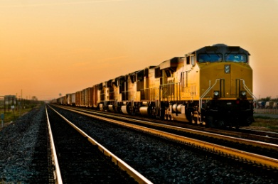
Pull System Example
Push vs. Pull Systems
Notes:
Do: Explain how the demand of the train causes the freight behind it to be pulled forward.

Slide 16
What Is a Pull System?
Push vs. Pull Systems
Definition
When to Use
A material pull system means that downstream processes fetch from upstream processes only the goods that are needed, only when they are needed, and only the required amounts
Operation cycle time limitations
Unreliable processes
Long lead time processes
Upstream processes operating in batch mode
Shared supply resources
“Pull where you cannot flow…”
Notes:
DO: Explain the desire to achieve production flow but may use a pull system to compensate (Kanban).
DO: Describe how product variations can complicate a pull system – reiterate when a pull system is appropriate.
DO: Mention that you may be at the temporary mercy of an unreliable supplier either internal or external. You must consider this when establishing your pull system and supermarket quantities to compensate for this until you take positive corrective action to correct this unreliability.
DO: Mention that long lead time processes do not lend themselves to sudden changes in demand and therefore the lead time must be a strong consideration in establishing your pull system.
DO: Mention that when you have upstream processes that are a shared resource in that they produce more than one product or part they can only product one thing at a time . This might be for example a press that may produce many parts. These parts because the press can produce only one type of product at a time, a supermarket would be in place to accommodate a smooth “pull” form this resource.
EXAMPLE: In a HUMVEE assembly line, there is not enough room to put the engine assembly area immediately on the assembly line. As a result, engine assembly is separated from the main line. How do you schedule the engine area? MRP, ERP, Expediting, Excel Spreadsheets, Production meetings? In a pull system, there would be a ‘signal’ from the assembly line to engine assembly. To prevent overproduction … or underproduction, the supplying area is scheduled “by the line”. When the assembly line needs one, they ‘pull’ one from the engine area.

Slide 17
Push System
Push vs. Pull Systems
Defined:
A Push System or Material Requirements Planning (MRP) is a complex computerized inventory production planning system with rules and procedures that support push/batch manufacturing.
Notes:
DO: Define a push system.
SAY: “MRP does not support small lot production, it “thinks” in large batches. MRP promotes use of forecasting and making to shop orders (not customer orders). MRP sends order information by department and instructs the department what to make but not in the sequenced amounts or required amounts needed by the customer. This is “pushing” the information and inventory down the value stream.”
DO: Provide an example of a push system and ask the participants to provide an example within or outside of their business.

Slide 18
Pull vs. Push
Push vs. Pull Systems
 | Pull System | Push System
Complicated Bill of Materials | No | Yes
Extensive computer system required to keep work order inventory status correct | No | Yes
Operations work blindly from one another | No | Yes
Provides good visual control | Yes | No
Easily managed by shop assoc. | Yes | No
Production based on customer orders | Yes | No
Notes:
DO: Highlight the differences between push and pull systems and how Kanban signals/cards are appropriate for Pull systems.
NOTE: This is not suggesting that we “do away” with MRP. There are appropriate uses for MRP which include being able to provide our suppliers with a forecast (creating a Planning Bill of Materials estimating what we need). MRP is also used for “backflushing”. In backflushing you are not issuing the materials until production is posted reported against the operation. The materials may be accumulated through whatever means are most efficient for your operation. Once the operation is completed, the operator will use MRP to post the production against the operation. The operator will generally enter the production order number, operation, quantity good, scrap quantity, and labor and machine information. The production reporting program will then bring up the issuing program using the sum of the good and scrap quantity to recalculate the materials required. The operator then issues all the materials as one transaction.
MRP systems also fulfill the purchasing part of the process and will issue blanket orders. With Lean, the actual release of materials from the order is done through kanban.

Slide 19
Goals of a Pull System
Push vs. Pull Systems
Synchronized, streamlined, one-piece production
Produce one unit of product at any time
Perfect quality to the customer
Near zero lead time
Closer match between the production plan and the order schedule
Only planned and necessary inventory is carried
Notes:
DO: Explain how these goals translate into real savings via inventory management, quality control, resource allocation, REDUCE overall inventory levels, etc..

Slide 20

Pull System Example
Push vs. Pull Systems
Notes:
Do: Explain how each link in the chain is like a process in a pull system. As you pull the chain, the processes follow in sequence behind each other.

Slide 21
Achieving a Pull System
Push vs. Pull Systems
Level the demand within reason to provide a repetitive production sequence based on customer requirements
Reduce and standardize lot size - ultimate goal of a lot size of 1
Use pull system to control material
Understand where your constraints are and where you need supermarkets
Transition from MRP push system to material pull system
Maintain replenishment system as demand and lead times change
KEY Point! Kanban is dynamic, you must review your calculations on a regular schedule depending on the variations of your particular business
Notes:
DO: Review how to achieve a pull system.
DO: Highlight the point that the transition from MRP push systems to material pull systems will be discussed shortly.
DO: Discuss the hidden issues and systems that must be addressed when converting from MRP to Pull:
BOM structure (use of phantoms)
Make/Buy component structure
Changing of Buyer or Planner Codes
Creation of “spike” reports to support the business
Introduction of multiple scheduling systems (master schedule, department schedules, kanban .. Etc
How to handle the integration of kanban and traditional scheduling (which you will almost always have .. For a while)
… etc

Slide 22

Do You Make to Order or to a Supermarket?
Push vs. Pull Systems
Goal is to have only one scheduling point
The answer to the above question will determine where that point needs to be in the process
Build to Supermarket:
Schedule
Process 1
Process 2
Process 3
Build to Order:
Schedule
Customer
STOP
If full
Process 1
Process 2
Process 3
Process 4
FIFO
FIFO
Customer
Notes:
DO: Describe the different processes and why they are different.
DO: Ask the class to provide example of each process within or outside of their business.

Slide 23

Transitioning from MRP (Push System) to Kanban
Push vs. Pull Systems
Assembly Cell
2 bin system to the excess area until depleted.
Supply Cell
Excess Inventory Area
Notes:
DO: Show an example of how a Kanban pull system works via a 2-bin system. Explain that a more detailed view of the 2-bin system is forthcoming.
A brief explanation is that parts from one bin are being consumed while the other bin is being replenished

Slide 24
Transitioned from MRP (Push System) to Kanban
Push vs. Pull Systems
Assembly Cell
Kanban
Post
Run Line
Card
attached to
full container
Parts are
“shopped” from
The supermarket
When Cards
Hit The Run Line
Signal the Supply
Cell to Replenish
Parts with
Card replenish the
supermarket
Supply Cell
Kanban
Notes:
DO: Explain that once the excess inventory is consumed, and if the supply cell produces multiple parts, a supermarket is established to supply other type of parts than the part currently in the supply cell.
Once parts are being removed from the container at the assembly cell, the Kanban Card is sent to the Kanban Post.
Once the Kanban card for that particular part number hits the run line, the Kanban cards are given to the Supply cell to produce.
Once the parts are produced, they are staged in the supermarket with the appropriate Kanban card attached.
The process repeats over and over.

Slide 25
Types of Kanban and How Kanban Works
Push vs. Pull Systems
Types of Kanban & How It Works
Kanban Calculations
Implementing Kanban
Objectives:
Differentiate transport from production kanban
Identify types of transport kanban
Identify types of production kanban
Define how the kanban process works
Notes:
DO: Review objectives of this section.

Slide 26
What is a Supermarket?
Types of Kanban & How It Works
Used to keep a calculated amount of inventory available to assure continuity when the product is produced by a shared resource.
Notes:
DO: Emphasize that the number of Kanban is a result of a mathematical calculation and not a best guess.

Slide 27
Types of Kanban
Types of Kanban & How It Works
Points Descriptions
Transport
Kanban
Used to indicate when one container of parts is to be moved to the production line
Authorizes withdrawal from feeding operation
Used for suppliers or in factory
1
2
Production
Kanban
Used to indicate when one or more containers of parts should be produced
Authorizes feeding operation to produce parts
Used in factory only
Notes:
DO: Describe the difference between transport and production Kanban.
DO: Describe a transport or a production Kanban without indicating the type and ask the class to indicate whether you are describing a transport or a production Kanban.
ASK: “Can a transport Kanban also be a Production kanban?”

Slide 28
Kanban Post
Types of Kanban & How It Works
Part Numbers
A | B | C
Fixed Run Line
A Kanban Card at the Run Line is a Signal to Replenish
Moveable Blocker Cards
Notes:
SAY: The Kanban Post is the place that the Kanban cards accumulate until they hit the run line. Once the cards hit the run line they signal the supplying machine, cell or supplier to replenish only in the total quantity noted on the Kanban card. DO NOT OVER PRODUCE!
The Blocker Card is movable and the run line is fixed. By the blocker card being movable, it makes it easier to change the number of Kanban cards needed to hit the run line as demand changes
The number of Kanban cards needed to hit the run line is a CALCULATED number. We will talk about these calculations later, the important thing to remember is that it IS a calculation.

Slide 29
Types of Transport Kanban
Types of Kanban & How It Works
Types of Transport Kanban
Withdrawal Kanban
These kanban are used between processes in the factory
Withdrawal
Kanban
Supplier Kanban
Supplier
Kanban
These kanban are sent as orders to outside suppliers
Notes:
DO: Explain the two types of Transport Kanbans and provide examples.
ASK: “Does every kanban system have to have a Transport, Withdrawal and Supplier kanban?”
ASK: “What are some critical factors to consider when implementing a supplier kanban?”
Supplier knowledge
Supplier engagement
PO structure (blankets, releases or?)
Role of Buyers and Planners (how does it change … who will teach them to change?
Execution capability of the supplier. Are they capable of receiving a fax and providing replenishment in the time period necessary?
How do you disable kanban parts from showing up on the exception report?

Slide 30
Withdrawal Kanban Example
Types of Kanban & How It Works
Part #
Description:
Yellow Lever
Supplying
Process
Consuming
Process
2345
Quantity Per
Container:
12345 Lever Cell
Assembly
6
Cell B-12
Deliver To:
Assembly Cell B-12
Card 1 of 7
Notes:
DO: Describe the Kanban card
ASK: “Does every card have to have the same information?”
DO: Explain that this can be treated the same as a credit card. Each card is for a specific quantity, and you are not allowed more than the quantity on the card.

Slide 31
Goal: Next order arrives as inventory hits safety stock
Types of Kanban & How It Works
Inventory Level
Inventory Curve
Demand should = EDDLT
Safety Stock = 307 units
Place Order
Lead Time 10 days
Reorder
Time
Notes:
DO: Remind the participants of the goal inventory stocking level.
NOTE: Safety stock is defined as extra units of inventory carried as protection against possible stockouts. It is held when an organization cannot accurately predict demand and/or lead time for the product. For example, if a manufacturing company were to continually run out of inventory, they would need to keep some extra inventory on hand so they could attempt to meet demand while they were producing more inventory. Safety Stocks enable organizations to satisfy customer demand in the event of these possibilities:
Supplier may deliver their product late or not at all
The warehouse may be on strike
A number of items at the warehouse my be of poor quality and replacements are in order
A competitor may be sold out on a product, increasing the demand for your products
Random Demand (In reality, random events occur)
Machinery Breakdown
...and other reasons
SAY: “When considering the EDDLT (Estimated Daily Demand Lead Time), consider that once you have reached your reorder point, your remaining inventory will continue to be consumed. The replenishment should occur before your inventory level dips into the safety stock however should you frequently dip into your safety stock it would indicate that you need to review your EDDLT as well as your safety stock level. The same is true should your replenishment occur well before you reach your safety stock line.”

Slide 32
Kanban Calculations
Push vs. Pull Systems
Types of Kanban & How It Works
Kanban Calculations
Implementing Kanban
Objectives:
Define the “Set-up Wheel”
Define Transport Lead Time and Production Lead Time
Calculate minutes available for changeover and lead time
Determine the impact that changeover has on lead time
Calculate number of kanban signals needed
Identify how to perform a Kanban Data Analysis and ABC Analysis
Notes:
DO: Describe to the participants that they will see and practice examples of calculating lead times, # of Kanbans, etc. and they will be able to use the worksheets provided and their hands-on training to practice the calculations.

Slide 33
Set-up Wheel
Kanban Calculations
Set-up Wheel
What is it?
Production
The time it takes to run (produce) all parts through a piece of equipment base upon demand and changeover, and available time on equipment
Part A
Part E
Production Lead Time
Part B
Is based on a production set up wheel which determines lead time through equipment
Part D
Part C
Notes:
SAY: “The wheel provides a pattern that will help level production.
The sequence in which parts occur on the wheel allows for grouping products that are made from like materials for set-ups which helps reduce the number of set-ups and allow us to optimize capacity. It also allows us the opportunity to view how long it will take us to produce the demand put upon the work center and if we can achieve the production required in the time available.”

Slide 34
Calculating Lead Time
Kanban Calculations
Determine daily demand for parts produced by equipment.
Determine Run Time per part
Calculate available time on equipment in minutes.
Calculate minutes available for changeover
Determine part to part changeover time.
Determine Lead Time
Notes:
DO: Provide an example for the participants.
Write the variables and the equation on a flip chart and fill in and calculate.
SAY: “This calculation is intended to determine if the producing machine (work center) is capable of ‘producing to flow’.”

Slide 35
Key Calculations
Kanban Calculations
Minutes Available for Changeover
Lead Time Calculation
Minutes
Available
for
Changeover
Available
Daily Time
on
Equipment
(mins)
(Daily
Demand
x
run time
(min))
# of parts on machine x
part to part
changeover (mins)
Lead Time
# Days
Mins available for
changeover/day
Notes:
NOTE: Continued from previous slide.
NOTE: An Important consideration that the kanban formulas here are fundamental formulas that are tried and true. There may come a time when you have a lot of variation in your demand that you may have to implement some modifications to your formulas. NOTE: you should visit your demand on a regular basis with attention to seasonality, product life cycle and variation in large variation in demand. The single highest reason for a kanban system to fail is failure to revisit your demand on a frequent basis.

Slide 36
Definitions
Kanban Calculations
Points Descriptions
1
Transport
lead time
The amount of time it takes to transport the part from the time the signal is sent to the time the part is received
2
Production
lead time
The amount of time it takes to produce the part from the time the signal is sent to the time the part is received
Includes the transport and production time of the part
3
Daily Demand
Current quantity level for a component
4
Order Frequency
Frequency at which the consuming process will take place
5
Safety Time
Estimate based on machine downtime, and variation in demand lead time
6
Container Quantity
Standard quantity a container holds
Also on Kanban card
Notes:
DO: Remind the participants of the goal inventory stocking level.
NOTE: Safety stock is defined as extra units of inventory carried as protection against possible stockouts. It is held when an organization cannot accurately predict demand and/or lead time for the product. For example, if a manufacturing company were to continually run out of inventory, they would need to keep some extra inventory on hand so they could attempt to meet demand while they were producing more inventory. Safety Stocks enable organizations to satisfy customer demand in the event of these possibilities:
Supplier may deliver their product late or not at all
The warehouse may be on strike
A number of items at the warehouse my be of poor quality and replacements are in order
A competitor may be sold out on a product, increasing the demand for your products
Random Demand (In reality, random events occur)
Machinery Breakdown
...and other reasons
SAY: “When considering the EDDLT (Estimated Daily Demand Lead Time), consider that once you have reached your reorder point, your remaining inventory will continue to be consumed. The replenishment should occur before your inventory level dips into the safety stock however should you frequently dip into your safety stock it would indicate that you need to review your EDDLT as well as your safety stock level. The same is true should your replenishment occur well before you reach your safety stock line.”
SAY: “Order frequency is the frequency at which the consuming process will take place. This is expressed in days or fractions thereof. This is calculated by dividing 1 day by the number of set-ups allocated to the product in the capacity analysis worksheet. Example: 1 day divided by 0.5 set-ups per day assigned to a product equals an order frequency of every 2 days (1/0.5=2)

Slide 37
Exercise: Impact of changeover on lead time
Kanban Calculations
Objective
Calculate minutes available lead time when changeover time is reduced.
Instructions
Time to Complete
With the data set from the previous exercise,
reduce the part to part changeover time
by 50% to 40 mins and determine new lead time.
Available Daily Time: 480 mins
Daily Demand Run Time: 410 mins
# of Parts on Machine: 10
Part to Part Changeover: 40 mins
Mins Available for Changeover: ________
Lead time: ___________
5 minutes
Deliverable
Answers to calculations
Notes:
SAY: “What was 11.4 days is now 5.7 days by reducing your changeover time by half!”
SAY: “This is the ‘financial’ magic of Kanban. If we leverage our capability to “set up” in 50% of the time, we can now work to aggressively ‘burn down’ the inventory levels (and CAPTURE CASH).”
ASK: “What happens if the amount of material you need is reduced by 50% to:
Floor space
Scheduling
Material Handling
Proximity of machines and work centers
??”

Slide 38
Calculating Kanban Signals
Kanban Calculations
Kanban Signal Calculation
Example
Daily Usage: = 100
Lead time = 5 days
Safety Stock = 1 day
Container Capacity = 75
Daily Usage x
(Lead time +
Safety Stock)
# of Kanban
Signals
100 x (5+1)
Container Capacity
8 Kanban
75
This equation applies when the signal is sent prior to the bin being empty
If the signal is sent AFTER the bin is empty, then one more signal must be added to the equation
8 Kanban + 1 = 9 Kanban
Notes:
DO: Walk through the example and provide a written example on a flip chart. Ask the class to calculate another example and volunteer an answer.

Slide 39
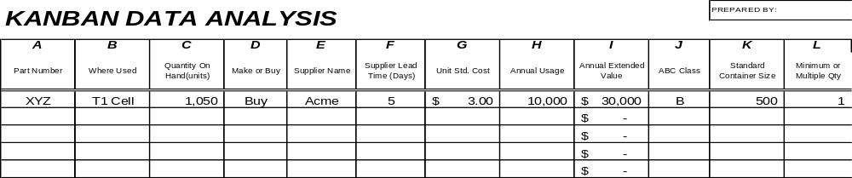
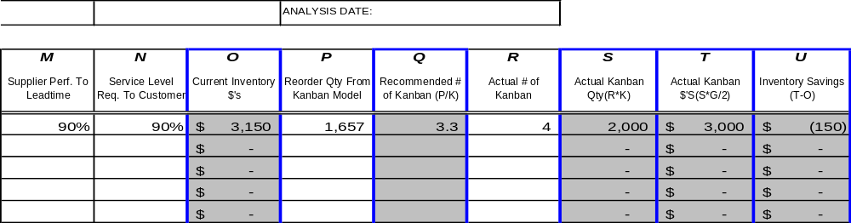
Kanban Data Analysis
Kanban Calculations
Notes:
DO: Walk through analysis.

Slide 40
ABC Analysis
Kanban Calculations
Purpose of the ABC Analysis
The business goal is to have on time delivery while minimizing inventory expense. We want to manage the most inventory dollars with our limited resources.
By closely managing A and B items (50% of the stock keeping units), we can control 95% of the inventory cost.
Notes:
DO: Describe the purpose of ABC analysis. Similar to the 80/20 rule.
SAY: “What do I kanban?” There is no single answer!
Keep in mind our objective:
Enable flow …
What risk factors are involved?
What kind of recovery can I make?
How big is the part?
Can I substitute if necessary?”

Slide 41
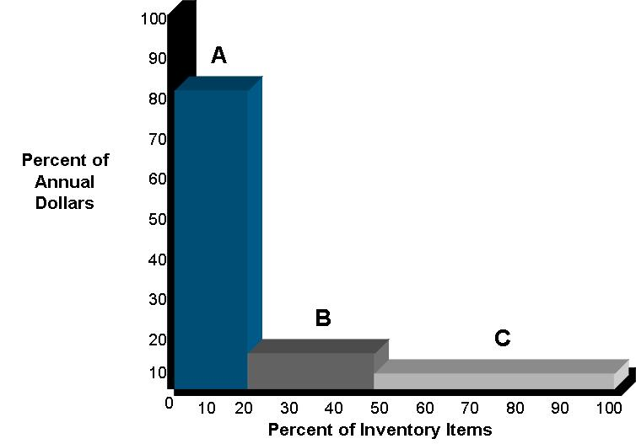
ABC Analysis Steps
Kanban Calculations
Multiply annual volume unit cost to obtain annual dollar volume for each stock keeping unit (SKU)
Rank SKU’s in descending extended dollar amount
Assign A,B,C rating to each SKU
  A – Top 80% of $
  B – Next 15% of $
  C – Bottom 5% of $
Notes:
DO: Review the steps to conducting an ABC analysis.
SAY: “You will always find this type of mix …”
NOTE: You WILL find that (in current conditions) there is almost NO correlation between lead time and inventory levels. e.g. You will have short lead time parts with 300 days of material on hand. A good Materials plan will be able to identify these and others to improve flow and release captured cash …

Slide 42
Kanban Calculation Problems
Kanban Calculations
How to Handle Spikes in Production
How to Determine Amount of WIP
What if I Loose a Card?
Is a Kanban a “Set it and Forget it” System?
Where do We Start?
Notes:
SAY:
How to handle spikes in production:
“You may see a spike in production that exceeds your normal Kanban quantity. We need to be able to respond to this demand but in a way that we do not trigger the Kanban to keep making extra product after the demand has been satisfied. This is accomplished by using one time, or single use, Kanban cards. They are issued in normal Kanban container quantities and injected into the system. The product is produced and the one time Kanban quantity is delivered to the supermarket. We will use this product first, before consuming the normal Kanban parts. Once the single use Kanban container is used, the single use card is returned to the planner, not the Kanban post – this takes the replenishment demand out of the process.”
How to determine amount of WIP:
“Your authorized WIP is an easy calculation. Take the number of Kanban cards and multiply by the card quantity.”
What if I loose a card?:
“This is a very important point. Our system integrity is only as good as we keep control of our cards. A good practice is to make the Kanban card larger than a shirt or pants pocket. This will prevent the card from ending up in the laundry! We validate the integrity of the number of cards in the system by periodically preforming a cycle count on them.”
Is a Kanban a “set it and forget it” system?:
“Absolutely not! Kanban is a dynamic system, and the demand needs to be revisited on a regular basis depending on the volatility of change in your particular products. Failure to do this will almost always end in problems.”
Where do we start?:
“Don’t try to eat an elephant in one bite! Start with one product and value stream. Let that product be your test drive to identify strengths and weaknesses in your implementation. Learn from that as you implement the Kanban in other products and value streams. Use it to build confidence and let others see it working – then branch out from there.”

Slide 43
Implementing Kanban
Push vs. Pull Systems
Types of Kanban & How It Works
Kanban Calculations
Implementing Kanban
Objectives:
Identify the steps to implement Kanban
Define metrics for measuring success with Kanban
Review the components of the Kanban Results Form
Discuss keys to success with Kanban
Notes:
DO: Review objectives of this section.

Slide 44
Steps to Implement Kanban
Implementing Kanban
Conduct an ABC analysis
Put together a demand analysis (see worksheet)
Using the data accumulated, make sure your allocation has overloaded one or more of your supplying sources.
Complete capacity analysis (see worksheet)
Revisit the number of days you plan to run your ABC parts
Notes:
SAY: Conduct an ABC analysis and determine what parts should be on Kanban and which should be on Kanban and which parts should be produced on an as needed basis. Decide on boundaries for replenishing.
In the ABC parts example “A” demand is greater than or equal to 100 per day, “B” is less than 100 but greater than 45, and “C” might be less than 45 per day.
Put together a demand analysis (see work sheet).
Demand analysis allows us to determine our resource allocation
Begin by listing all product part numbers that run through a particular resource. Notate daily demand.
Assign ABC classification to each part
Understand cycle time of machines/cells for each part number.
Often times the cycle time can vary from machine to machine or cell to cell
DO: Select machine or cell if there are multiple sources of supply. Allocate the load across the machines or cells, understand that the cycle time of the different supplying machines or cells may vary. (See worksheet for machine cycle time analysis)
SAY: Using the data accumulated, make sure your allocation has overloaded one or more of your supplying sources.
Complete the capacity analysis worksheet (See copy). Caution, always try to leave some time for un-allocated set ups, (emergency jobs will happen)
Now that you understand your capacity, you may need to revisit the number of days you plan to run your ABC parts to make sure that you will enough time in the day to accommodate the number of set ups that you will need.
Remember, all parts do not need (or deserve) to be on Kanban. Eliminate the odd, one-off parts from the process. You will want to run your “A” parts more frequently, the “B” parts less frequently and the “C” parts even less frequent – perhaps only once every 4-5 weeks. By running the “A” items more often, we reduce the opportunity to have too much inventory. We can run the “C” items less often because weeks worth of them likely represent a small % of total inventory costs.

Slide 45
Measuring Progress
Implementing Kanban
Number of Stock-Outs
Inventory Levels
Square Footage
Number of Inventory Transactions
Supplier Performance (Internal and External)
Lead Time
Notes:
DO: Describe how the participants will need to benchmark improvements by implementing the Kanban system. This slide provides some sample performance indicators that measure success.

Slide 46
Kanban Inventory Improvements – Results Form
Implementing Kanban
Savings
Beginning
Inventory
Ending
Inventory
Items
# of SKU's
Total
Excess
Obsolete
A
$0.00
B
$0.00
C
$0.00
Totals
0
$0.00
$0.00
$0.00
Space
Before Kaizen
After Kaizen
Savings
Square Feet
0

Slide 47
Prepare for Final Report-Out to Management
Implementing Kanban
All team members should contribute to the final report-out presentation to management
Report-out should include
  Introduction of Team
  Review of Event goals and objectives
  Review of Former Process and Documentation Forms
  Review of Improvement Opportunities Identified and Implemented
  Review of Documentation and Kaizen Results Form
  Review of Kaizen Newspaper
Typical Report-Out times are 15 minutes for presentation and 15 minutes for questions
Notes:
DO: Cover report-out guidelines.

Slide 48

Maintaining Kanban
Implementing Kanban
Key to Success
Key to success is to manage the kanban system
Kanban is a rigorous and disciplined process
Start with focus on execution of the critical few before expanding
Notes:
SAY: “Kanban is a manual process and must be managed carefully – risks of human error. If implemented and managed, Kanban can be highly successful.”
SAY: “Kanban is a disciplined process that must be managed with rigorous MDI.”
SAY: “Kanban should be used to systematically reduce inventory in pursuit of the next rock to fix.”

Slide 49
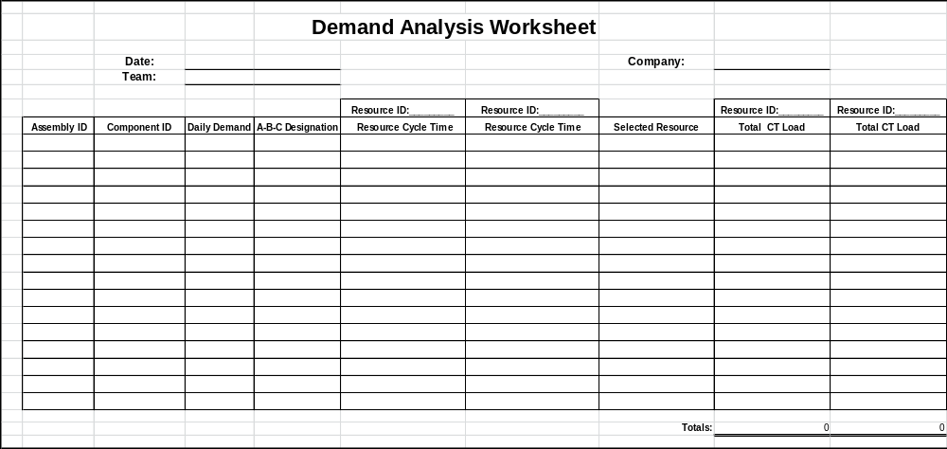
Demand Analysis Worksheet
Implementing Kanban
Notes:
NOTE: This worksheet is provided to show what the worksheet looks like. The same demand analysis worksheet is provided later for demonstration.

Slide 50
Steps to Implement Kanban – Machine Allocation
Implementing Kanban
Fill out the machine allocation table
  Refer to our ABC analysis
  Understand machine cycle times
  Load ABC accordingly
Notes:
DO: Explain when filling out the machine allocation table, that you should refer to the ABC analysis to understand machine cycle times. If there is more than one resource available, load the “A”’s on the resource with the fastest cycle times, then cascade the “B”’s and “C”’s accordingly.

Slide 51
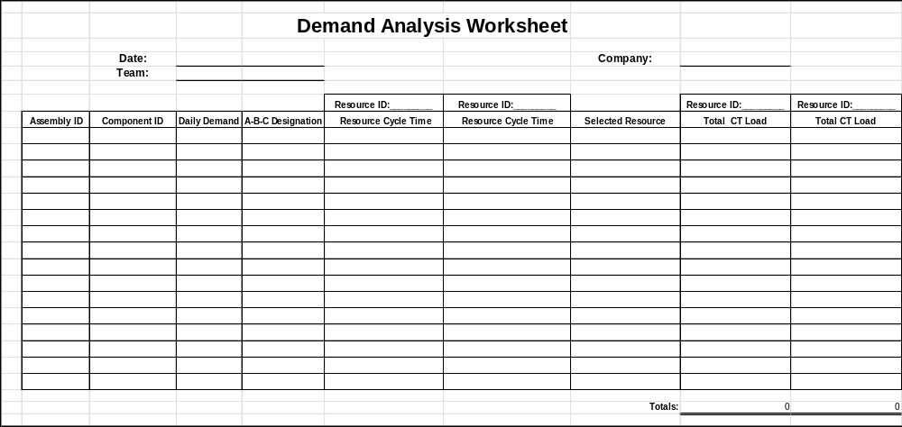
Demand Analysis Worksheet
Implementing Kanban
Notes:
DO: Show how to complete the demand analysis worksheet.
NOTE: The worksheet is embedded as a Microsoft Excel worksheet. You can edit the file from within this presentation, however not while it is in the full screen slideshow. Press “Esc” to exit the slide show, then right click the object, select “Worksheet Object” then edit. Alternatively, if it is easier, you can have this file opened in Excel on the side.

Slide 52
Steps to Implement Kanban - Capacity Analysis
Implementing Kanban
Take into account set up times
Total time available in a day
Calculate machine (or cell) cycle time
Calculate set up time
Notes:
SAY: This process takes into account the set up times for each supply resource, the total time available in a day, the uptime of the supply resource which will then give us the net available time.
We calculate the total machine (or cell) cycle time to determine the total cycle time. We subtract the cycle time from net available time to reach the time left for set-ups. We take the time available for set-up and divide by time per set-up to determine the maximum number of set-ups we could expect.
Please always allow some time for unallocated set-ups to accommodate drop in demand

Slide 53
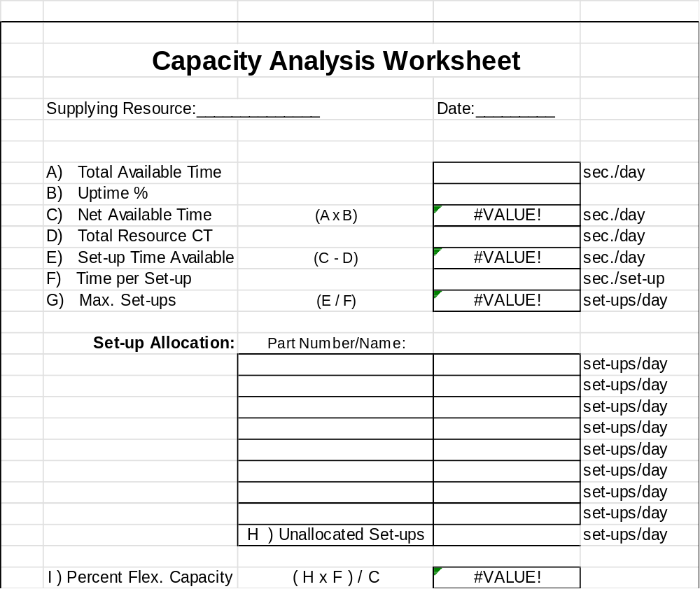
Capacity Analysis Worksheet
Implementing Kanban
Notes:
DO: Show how to complete the capacity analysis worksheet.
NOTE: The worksheet is embedded as a Microsoft Excel worksheet. You can edit the file from within this presentation, however not while it is in the full screen slideshow. Press “Esc” to exit the slide show, then right click the object, select “Worksheet Object” then edit. Alternatively, if it is easier, you can have this file opened in Excel on the side.

Slide 54
Steps to Implement Kanban – Kanban Cards
Implementing Kanban
Calculate the number of Kanban cards needed
Should understand:
  Number of Kanbans
  Daily Demand
  Order Frequency
  Lead Time
  Safety Time
  Container Quantity
Notes:
DO: Explain the formula to calculate the number of Kanban cards needed.
The formula is as follows:
Number of Kanbans + Daily Demand X Order Frequency + Lead Time + Safety Time ÷ Container Quantity

Slide 55
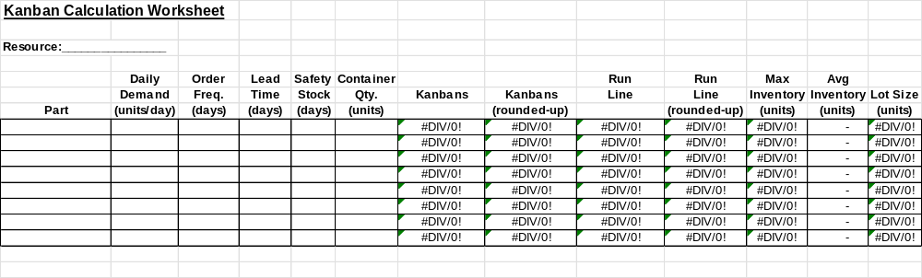
Kanban Calculation Worksheet
Implementing Kanban
Notes:
DO: Show how to complete the Kanban calculation worksheet.
DO: Explain that the calculations used in this worksheet are the same ones used by Toyota.
NOTE: The worksheet is embedded as a Microsoft Excel worksheet. You can edit the file from within this presentation, however not while it is in the full screen slideshow. Press “Esc” to exit the slide show, then right click the object, select “Worksheet Object” then edit. Alternatively, if it is easier, you can have this file opened in Excel on the side.

Slide 56
Final Note
Implementing Kanban
Once your Kanban is in place, your inventory may grow temporarily
Your Kanban supermarket part quantities are being adjusted
Notes:
SAY: “Once your Kanban is in place, you might find that your inventory will grow. This is a temporary “growing pain” due to the fact that you are filling your Kanban supermarkets with the correct quantities of the correct parts. You also may have too many of other parts that you already had on hand that must be worked down.
You can work these down by identifying them with single use Kanban cards. Consume these parts first before you start drawing on stock that is identified with a standard Kanban card.”

Slide 57
Review Exercise
Implementing Kanban
2 Minute Review
In pairs, or in small groups, spend 2 minutes discussing key learnings and take-aways from this Kanban Event thus far
One person from each group will share one learning that was discussed with the rest of the class

Slide 58
Other Modules In This Series:
5S
Standard Work
Total Productive Maintenance (TPM)
Administrative Lean
Cell Design/ Production Preparation Process (3P)
Kaizen
Kanban
Problem Solving
Poka Yoke Quality Systems
Transaction Process Improvement (TPI)
Cause & Effect Diagram with the Additions of Cards (CEDAC)
Single Minute Exchange of Dies (SMED)
Value Stream Mapping (VSMi®)
Visual Management
Managing Daily Process Excellence
For More Information Please Contact:
Mark DeLuzio, President and CEO
+1.860.234.0915
mark.deluzio@leanhorizons.com
Strategically Creating Value Through the Elimination of Waste

